Slide 1

Operating System
Lecture: 8

Slide 2

Operating system structures
Different Operating Systems and Their Features (Windows, MacOS)

Slide 3
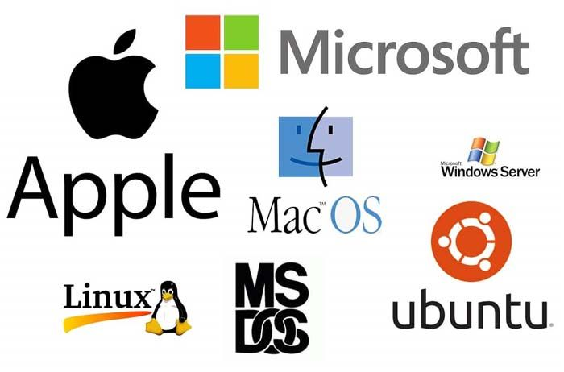
What is Operating System ?
An Operating System (OS) is a collection of software that manages computer hardware resources and provides common services for computer programs.
An operating system acts as an interface between the software and different parts of the computer or the computer hardware. It controls and monitors the execution of all other programs that reside in the computer, which also includes application programs and other system software of the computer.
Examples include: Windows, Linux, Mac OS, etc.

Slide 4
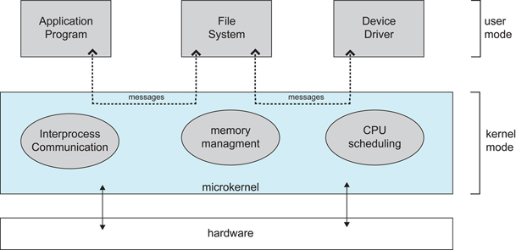
System Structure
The interconnections between the various operating system components can be defined as the operating system structure. The operating system is divided into various different structural types: simple structure, monolithic approach, layered approach, micro-kernels, exokernels, and virtual machines.

Slide 5
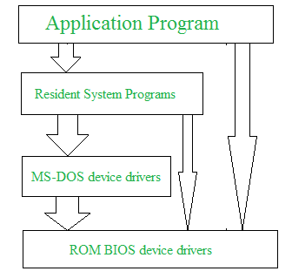
Simple/Monolithic Structure
A monolithic structure refers to an operating system design where all system services, such as device drivers and file management, run within a single kernel. Examples include older versions of Unix and Linux kernels.

Slide 6
Simple/Monolithic Structure
Advantages
It delivers better application performance because of the few interfaces between the application program and the hardware.
It is easy for kernel developers to develop such an operating system.
Disadvantages
The structure is very complicated, as no clear boundaries exist between modules.
It does not enforce data hiding in the operating system.

Slide 7
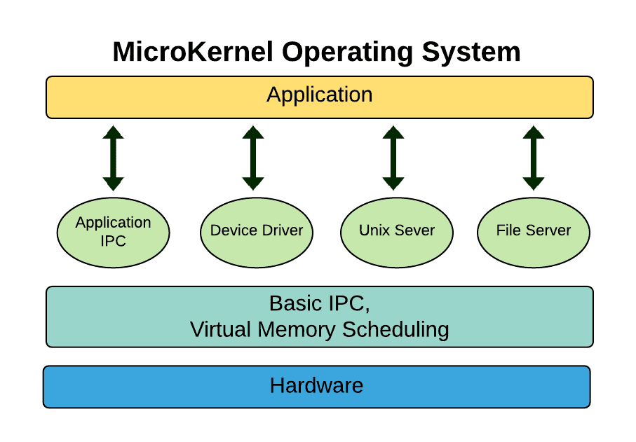
Microkernel Structure
Microkernel structure designs the operating system by removing all non-essential components from the kernel and implementing them as system and user programs. This results in a smaller kernel called the micro-kernel.
Examples of microkernel-based operating systems include QNX and MINIX.

Slide 8
Microkernel Structure
Advantages
It makes the operating system portable to various platforms.
As microkernels are small so these can be tested effectively.
Since most services run in user space, a failure in one service does not crash the entire system
Disadvantages
Increased level of inter module communication degrades system performance.
Designing efficient IPC(Inter Process Communication) mechanisms is complex and can be challenging to implement correctly.

Slide 9
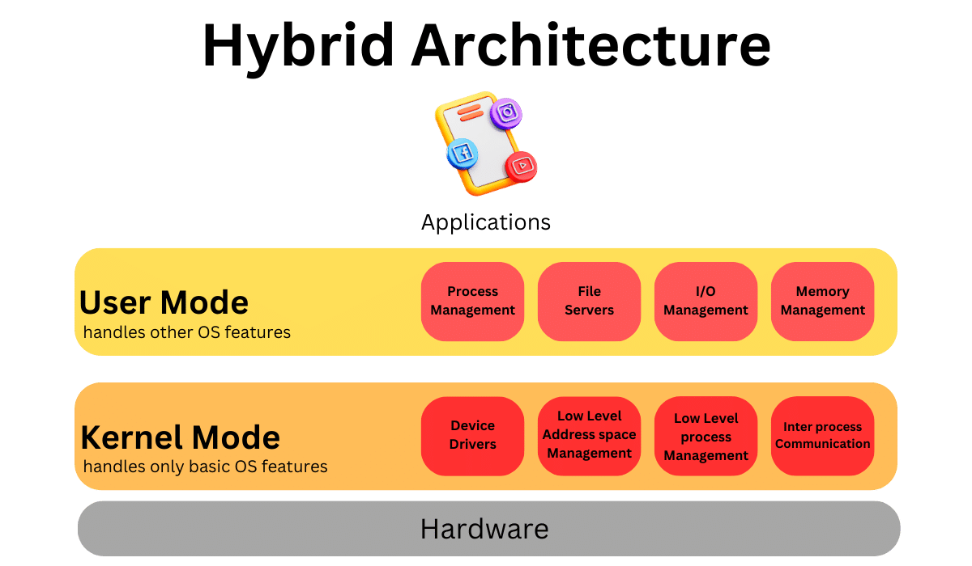
Hybrid-Kernel Structure
A hybrid-kernel structure is an operating system design that combines elements of both monolithic and microkernel architectures.
Examples of operating systems using hybrid-kernel structures include Windows NT and macOS.

Slide 10
Hybrid-kernel Structure
Advantages
It offers good performance as it implements the advantages of both structure in it.
It supports a wide range of hardware and applications.
It provides better isolation and security by implementing micro-kernel approach.
It enhances overall system reliability by separating critical functions into micro-kernel for debugging and maintenance.
Disadvantages
It increases overall complexity of system by implementing both structure (monolithic and micro) and making the system difficult to understand.
The layer of communication between micro-kernel and other component increases time complexity and decreases performance compared to monolithic kernel.

Slide 11
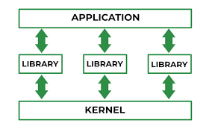
Exo-Kernel Structure
An exokernel is an operating system architecture where the kernel provides minimal abstractions to applications, allowing them to directly manage hardware resources.

Slide 12
Exo-kernel Structure
Advantages
Support for improved application control.
Separates management from security.
It improves the performance of the application.
A more efficient use of hardware resources is made possible by accurate resource allocation and revocation.
It is simpler to test and create new operating systems.
Disadvantages
A decline in consistency.
Exokernel interfaces have a complex architecture.

Slide 13
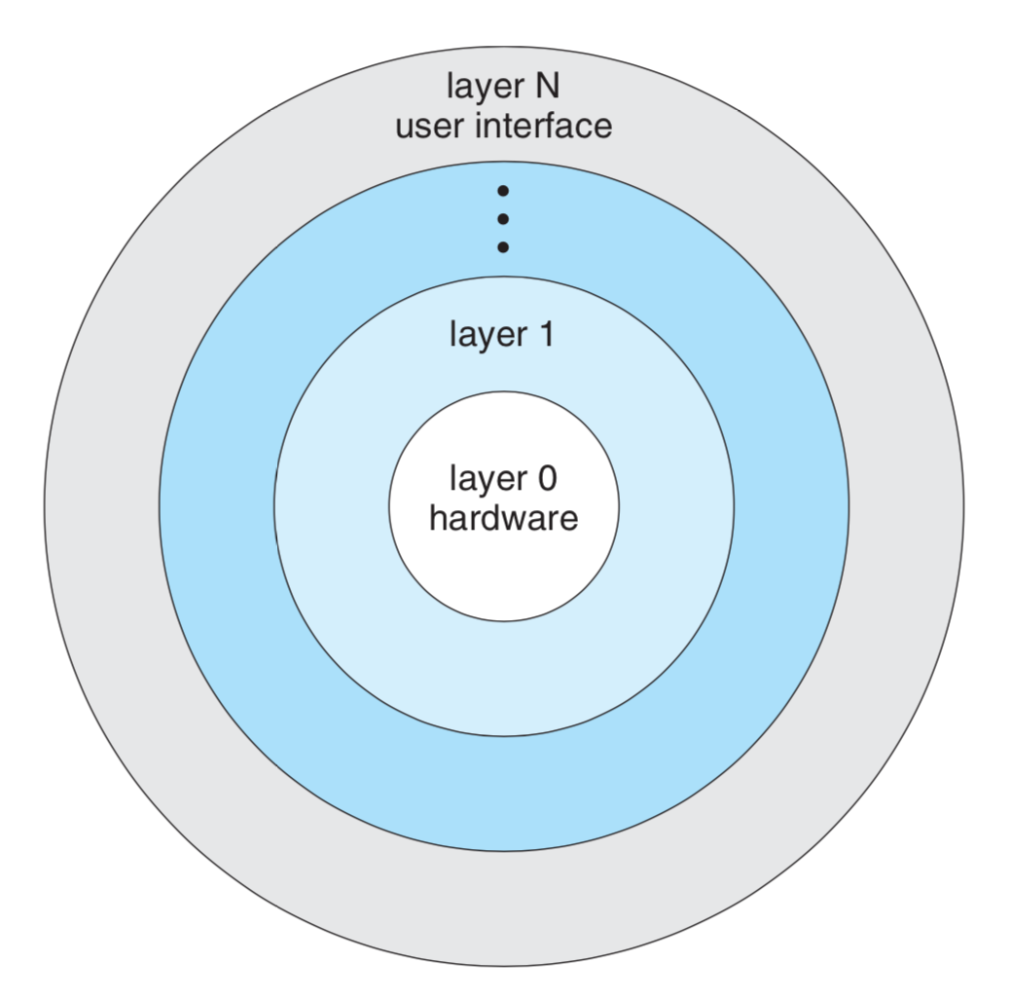
Layered structure
A layered structure in an operating system is an architectural design that organizes the system into a hierarchy of layers, each built on top of the one below it. Each layer provides a set of services to the layer above and uses the services of the layer below.

Slide 14
Layered Structure
Advantages
Layering makes it easier to enhance the operating system, as the implementation of a layer can be changed easily without affecting the other layers.
It is very easy to perform debugging and system verification.
Disadvantages
In this structure, the application’s performance is degraded as compared to simple structure.
It requires careful planning for designing the layers, as the higher layers use the functionalities of only the lower layers.

Slide 15
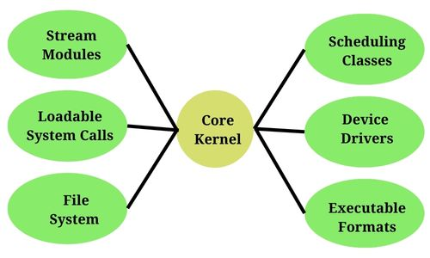
Modular structure
A modular structure in an operating system refers to a design where the system is divided into separate modules, each handling a specific functionality or service. These modules can be dynamically loaded and unloaded as needed, allowing the system to be more flexible and adaptable. The core kernel remains small and simple, while additional features are added through modules.

Slide 16
Modular Structure
Advantages
Modules can be added or removed without affecting the core kernel, allowing for easy customization and updates.
Bugs or issues can be isolated within individual modules, making them easier to identify and fix without impacting the entire system.
New functionalities can be added as separate modules, facilitating system expansion and upgrades.
Disadvantages
The dynamic nature of loading and unloading modules can introduce complexity in managing.
The mechanisms for managing modules can add some overhead to the system.
If not properly managed, dynamically loading modules can introduce security vulnerabilities, especially if modules are not properly authenticated or verified.

Slide 17
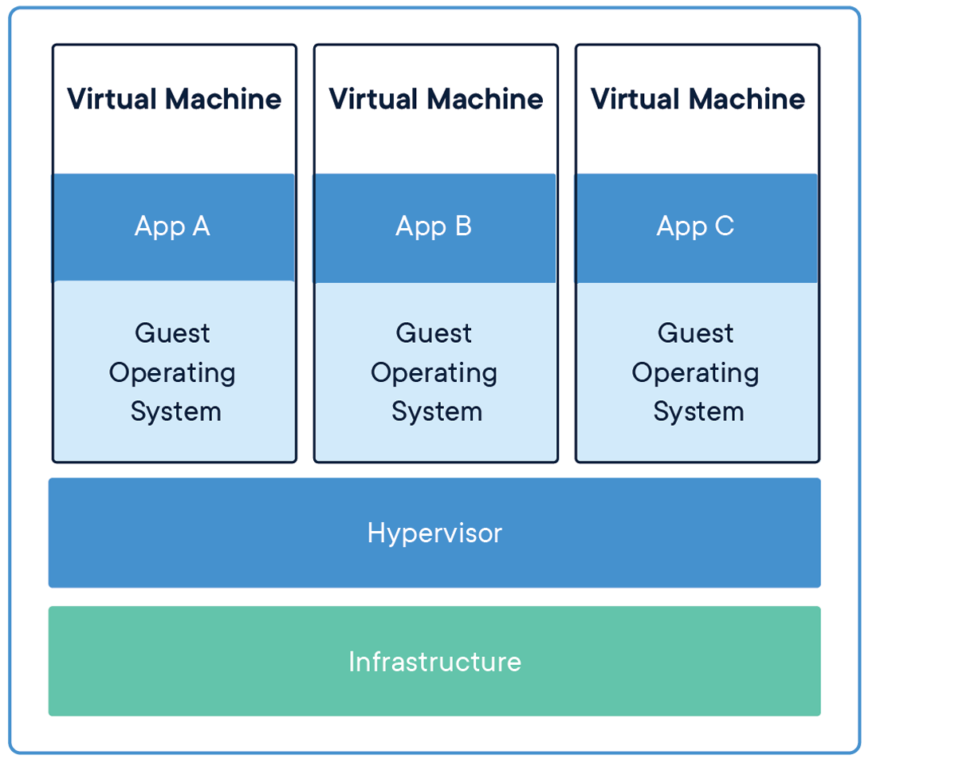
Virtual Machine
A virtual machine (VM) is an emulation of a computer system that provides the functionality of a physical computer. VMs are created using software called a hypervisor, which runs on a physical host machine and allocates resources like CPU, memory, and storage to the virtual machines. Each VM runs its own operating system and applications as if it were a separate physical machine.

Slide 18
Virtual Machine
Advantages
Each VM operates independently, so issues in one VM do not affect others.
Multiple VMs can run on a single physical machine, maximizing hardware utilization and reducing costs.
VMs can run different operating systems and applications on the same physical hardware, providing a versatile environment for testing and development.
Disadvantages
Running multiple VMs introduces additional overhead due to the hypervisor.
Multiple VMs sharing the same physical resources can lead to contention.
Managing a large number of VMs and their associated resources can become complex, requiring specialized tools and expertise.

Slide 19

Let’s do some exercises!

Slide 20

Exercises
What is a Microkernel?
What is a Hybrid Kernel?
What is a Virtualization-based Kernel?
List one service you would place in kernel space and one in user space in a hybrid-kernel system.
Write down one benefit of using a layered structure in an operating system.
List one advantage of using virtual machines.

Slide 21
Thanks!

